Slide 1

Probability
Placement Preparation
Aptitude & Reasoning
Prof. Krunal D. Vyas
Computer Engineering Department
krunal.vyas@darshan.ac.in
9601901005

Slide 2
Introduction
Random experiment
A random experiment is an experiment or a process for which the outcomes cannot be predicted with certainty.
For example, the process of rolling an unbiased dice, tossing a fair coin, drawing a card from a pack of well shuffled card, picking up a ball of certain color from a bag containing balls of different colors, etc… are known as random experiment.
Sample space
The set of total possible outcomes in a random experiment is known as sample space denoted by S.
For rolling a dice S = {1, 2, 3, 4, 5, 6}
For tossing a coin once, S = {H, T}
If two coins are tossed, then S = {HH, HT, TH, TT}

Slide 3
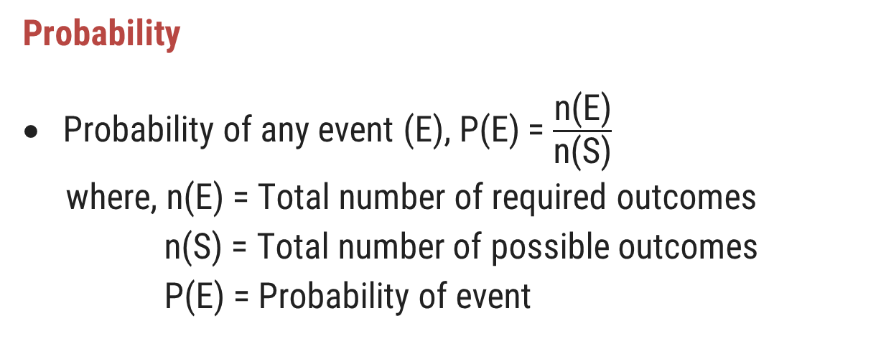
Introduction
Probability
Probability of any event (E), P(E) = $\frac{\text{n}\text{(}\text{E}\text{)}}{\text{n}\text{(}\text{S}\text{)}}$
where, n(E) = Total number of required outcomes
n(S) = Total number of possible outcomes
P(E) = Probability of event

Slide 4
Examples
Example-1: Find the probability of head when single coin is tossed.
Solution-1: n(E) = 1 {H}, n(S) = 2 {H, T}
P(E) = 1/2
Example-2: Find the probability of at most one head when two coins are tossed simultaneously.
Solution-2: n(E) = 3 {TT, TH, HT}, n(S) = 4 {HH, HT, TH, TT}
P(E) = 3/4
Example-3: Find the probability of getting a multiple of 3 when one dice is thrown once.
Solution-3: n(E) = 2 {3, 6}, n(S) = 6 {1, 2, 3, 4, 5, 6}
P(E) = 2/6 = 1/3

Slide 5
Examples
Example-4: Find the probability that sum is divisible by 4 when two dice are thrown simultaneously.
Solution-4: n(E) = 9 {1+3, 2+2, 2+6, 3+1, 3+5, 4+4, 5+3, 6+2, 6+6}, n(S) = 36
P(E) = 9/36 = 1/4
Example-5: If from a pack of 52 cards, 1 card is drawn at random. Find the probability that the card is King card.
Solution-5: n(E) = ⁴C₁ = 4, n(S) = ⁵²C₁ = 52
P(E) = 4/52 = 1/13

Slide 6
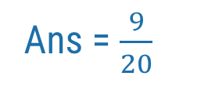

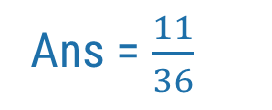
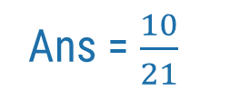
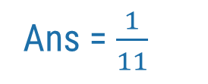
Exercise
Ans = $\frac{1}{6}$
Ex-1: In a simultaneous throw of two dice, what is the probability of getting a doublet?
Ex-2: Tickets numbered 1 to 20 are mixed up and then a ticket is drawn at random. What is the probability that the ticket drawn has a number which is a multiple of 3 or 5?
Ex-3: A basket contains 4 red, 5 blue, and 3 green marbles. If 2 marbles are drawn at random from the basket, what is the probability that both are red?
Ex-4: Four persons are chosen at random from a group of 3 men, 2 women, and 4 children. The chance that exactly 2 of them are children, is?
Ex-5: A bag contains 4 red balls, 6 blue balls, and 8 pink balls. One ball is drawn at random and replace with 3 pink balls. A probability that the first ball drawn was either red or blue in color and the second ball drawn was pink in color?
Ans = $\frac{9}{20}$
Ans = $\frac{1}{11}$
Ans = $\frac{10}{21}$
Ans = $\frac{11}{36}$

